Slide 1

Rationale
Introduction to Windows Store App Development Using HTML5 and JavaScript
Computer science is a field of study that deals with solving a variety of problems by using computers.
  To solve a given problem by using computers, you need to design an algorithm for it.
Multiple algorithms can be designed to solve a particular problem.
An algorithm that provides the maximum efficiency should be used for solving the problem.
  The efficiency of an algorithm can be improved by using an appropriate data structure.
Data structures help in creating programs that are simple, reusable, and easy to maintain.
This module will enable a learner to select and implement an appropriate data structure and algorithm to solve a given programming problem.

Slide 2
Objectives
  In this session, you will learn to:
  Implement data binding
Notes:
2

Slide 3
Implementing Data Binding
  When an application is used, data is accepted from the user through various UI elements.
  Similarly, data is displayed to the user using various UI elements.
  To implement this functionality in an app, the app data needs to be bound with the UI.
  While implementing data binding in an app, the data manipulation code may tend to be strongly coupled with the UI.
  If you make some changes to the UI, the corresponding code would also need to be changed.
Notes:
3

Slide 4
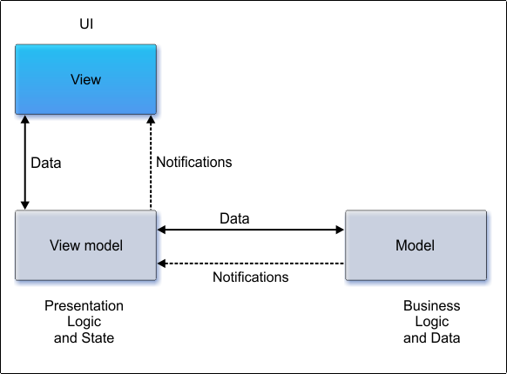
Introduction to MVVM
  The basic idea behind Model-View-View-Model (MVVM) is the separation of UI from code.
  An application that uses MVVM separates business logic, UI, and presentation behavior, as three different components, as shown in the following figure.
Notes:
4

Slide 5
Introduction to Data Binding
Data binding provides a means to bind the UI elements with the data objects so that the data can flow between the two.
While using data binding, changes made by the user in the UI element can be automatically saved to the data object and vice versa.
Notes:
5

Slide 6
Binding UI Elements to Data
Let us view an animation, which explains data binding
Notes:
6
Explain the parameters of the syntax.

Slide 7
Binding UI Elements to Data (Contd.)
  To implement OneTime data binding:
  Bind the properties of the data source object with the specific properties of the UI element.
  Use the data-win-bind attribute.
  Call the WinJS.Binding.processAll() function to bind the values of the data source object with the values of the UI elements.
Notes:
7
Explain the parameters of the syntax.

Slide 8
Binding UI Elements to Data (Contd.)
  To implement OneWay data binding:
  Convert the object into a binding context by using the WinJS.Binding.as() function.
  Example:
    The following code snippet convert the story object into a binding context by using the WinJS.Binding.as() function:
  var bindingSource = WinJS.Binding.as(story);
Notes:
8
Explain the parameters of the syntax.

Slide 9
Binding UI Elements to Data (Contd.)
  Windows Store apps that are developed using HTML5 and JavaScript, by default, do not support TwoWay data binding.
  However, you can do a workaround to get the benefits of TwoWay data binding.
  For this, you need to handle the onkeypress or onchange event of the UI elements, such as a text box, and update the properties of the data source accordingly.
Let us look at an example, which binds UI elements to data in an app
Notes:
9
Explain the parameters of the syntax.

Slide 10


Just a Minute
  Identify the function that is used to bind the values of the data source object with the values of the UI elements.
    1. WinJS.Binding.processAll()
    2. WinJS.Binding.as()
    3. WinJS.Binding.As()
    4. WinJS.Binding.ProcessAll()

Slide 11
Just a Minute (Contd.)
  Solution:
    1. WinJS.Binding.processAll()

Slide 12
Using Data/ Collection Controls
  Windows Store apps have a set of data/ collection controls, such as:
ListView
FlipView
Notes:
12
Explain the parameters of the syntax.

Slide 13
Using Data/ Collection Controls (Contd.)
  The ListView control:
  Can be used to display a collection of items.
  Can be added to an app by using the <div> tag and specifying its data-win-control property as WinJS.UI.ListView.
  Can be customized by using the various properties, such as:
    currentItem
    itemDataSource
    groupDataSource
    itemTemplate
    selection
    selectionMode
    layout
  Supports various events such as, oniteminvoked and onselectionchanged.
Notes:
13
Explain the parameters of the syntax.

Slide 14
Summary
  In this session, you learned that:
  MVVM is designed to address the problem of coupling between code and UI elements.
  Data binding provides a means to bind the UI elements with the data objects so that the data can flow between the two.
  You can use the ListView control to display a collection of items.
Notes:
14

Slide 15

Q&A

